Slide 1
Lung Cancer detection Data 606: Capstone in Data Science Professor: Chaojie Wang
Presented By:
Swapan Gupta Chollati
RJ29255

Slide 2
Introduction
Lung cancer is a deadly disease that claims millions of lives each year, and early detection is critical for successful treatment.
In this project, I aim to develop a machine learning model that can accurately detect lung cancer considering the columns in dataset.
By leveraging advanced techniques in deep learning, I hope to create a tool that can help doctors make more informed decisions and improve patient outcomes.

Slide 3
Importance
These days, number of patients having lung related problems are increasing.
And due to various reasons, number of people susceptible to lung cancer is increasing.
However, it is costly and difficult to perform cancer tests to all these people.
So a model which can detect lung cancer just by inputting few identifiable things would reduce the cost a lot by reducing the number of patients to test.

Slide 4
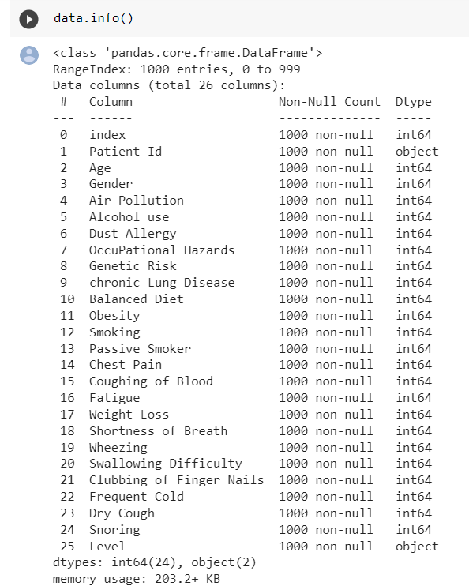
Dataset
a
I collected the data from the below link
https://www.kaggle.com/code/sripadkarthik/lung-cancer-prediction-using-ml-and-dl/data
The dataset has 1000 units of analysis

Slide 5
Variables or measures
Below are the variables I am considering for analysis
Age
Gender
Air Pollution
Alcohol use
Dust Allergy
OccuPational Hazards
Genetic Risk
chronic Lung Disease
Balanced Diet
Obesity
Smoking
Passive Smoker
Chest Pain
Coughing of Blood
Fatigue
Weight Loss
Shortness of Breath
Wheezing
Swallowing Difficulty
Clubbing of Finger Nails
Frequent Cold
Dry Cough
Snoring

Slide 6
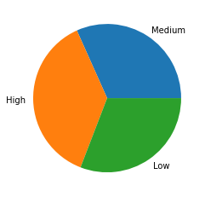
Exploratory Data analysis
Label distribution:
Here, the data is almost equally distributed, This is good for using classification models.

Slide 7
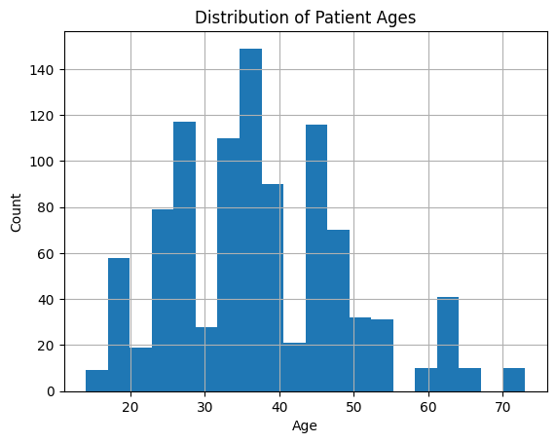
Exploratory Data analysis
Distribution of Patient Ages

Slide 8
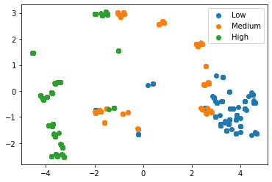
Exploratory Data analysis
Scatter plot of data points on plane

Slide 9
Preprocessing - Min - Max scaling :
MinMax scaling is a data preprocessing technique used to transform numeric data into a specific range, typically between 0 and 1.
This ensures that all data points are scaled proportionally to each other, without distorting the relative differences between them.
a

Slide 10
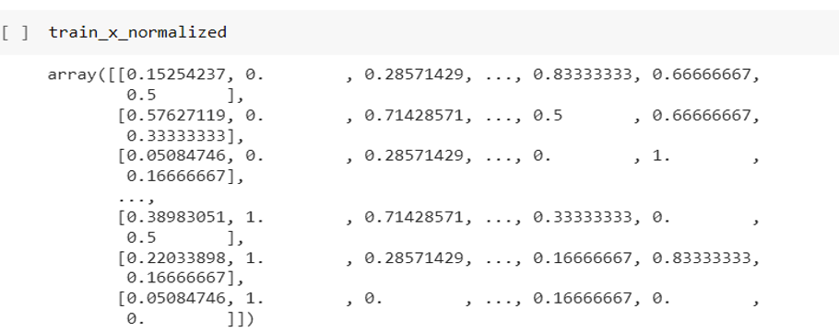
Preprocessing
a

Slide 11
Preprocessing - One hot encoding :
One hot encoding is a process of converting categorical information into a format that can be used by Machine learning algorithms.
The target variable contains 3 still values low, medium and high.
The 3 values are vectorized as Low-100, Medium-010, High-001 and the returned sparse matrix is converted to dense matrix by using todense function.

Slide 12
Models
Models are trained and analysed
K- nearest neighbours
Decision tree
Logistic regression
The confusion matrix is drawn for analysis

Slide 13
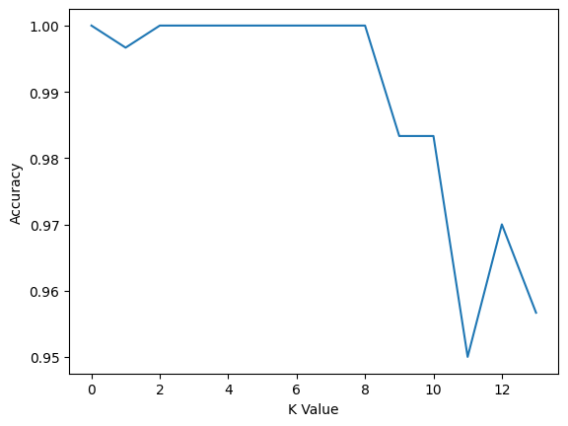
Model - K- nearest neighbours
KNN has been performed with different values for k and the respective accuracy values are plotted as below

Slide 14
Model - K- nearest neighbours
We can see how accuracy increased until k is 3 and decreased after k is 7. Similar case was oserved with different proportions of testsets with different random states. So taking k as 5 which was the mean in many cases.
By taking k as 5 validations are performed and the results are given in results section

Slide 15
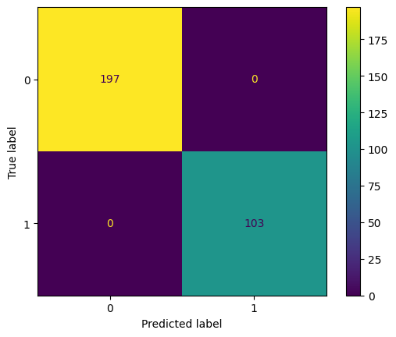


Confusion Matrix : KNN
High Low Medium

Slide 16
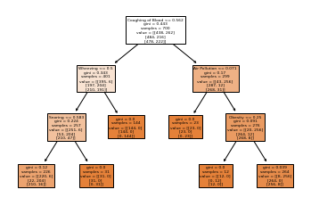
Model - Decision Tree

Slide 17
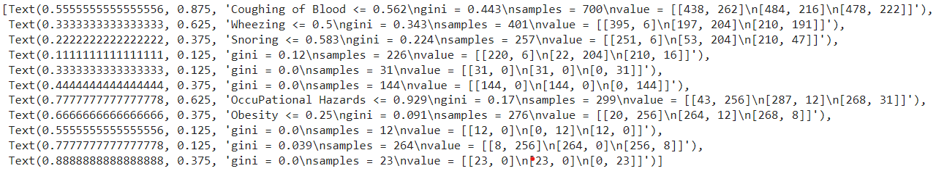
Decision Tree
qqq

Slide 18

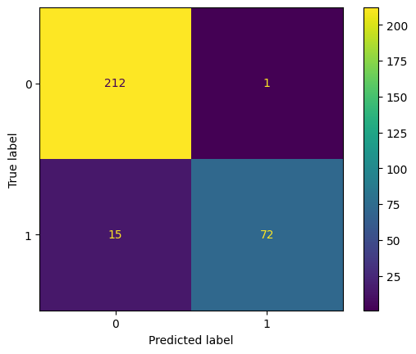
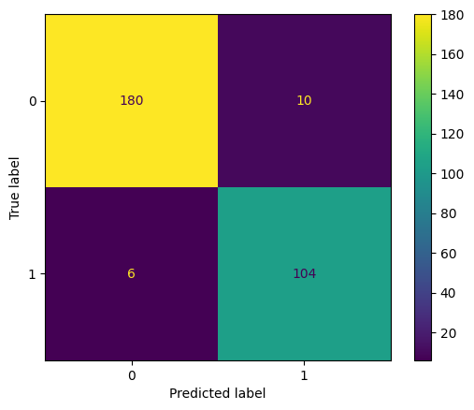
Confusion Matrix : Decision Tree
High Low Medium

Slide 19
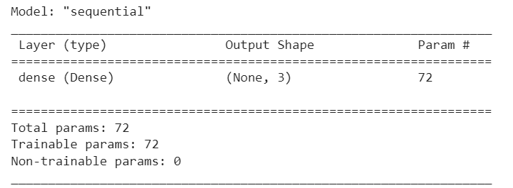
Model - Logistic regression
Model summary:

Slide 20
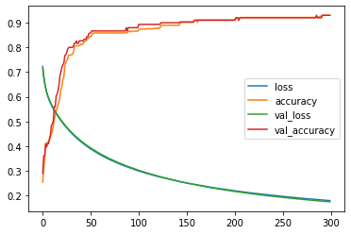
Logistic regression - loss and acc curves

Slide 21
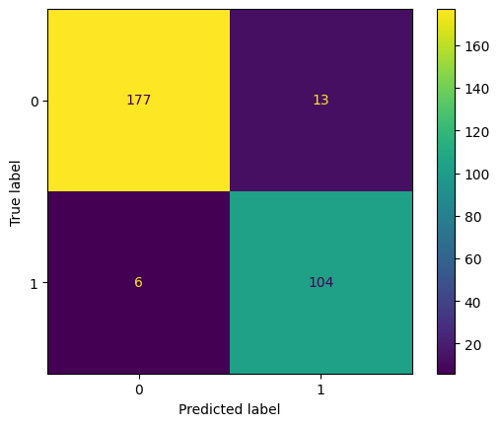
Confusion Matrix : Logistic Regression
High Low Medium

Slide 22
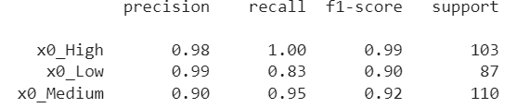
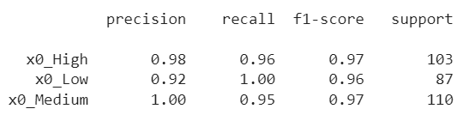
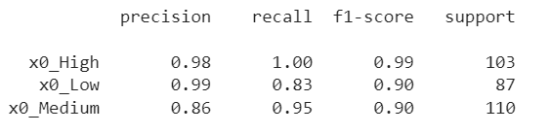
Results
K nearest neighbours
Decision Tree
Logistic regression

Slide 23
Decision
This is a case where we should be alarming as much patients as possible. Here, the deciding factor is False negative as it could put the patient at risk. So We will be considering recall of high risk patients as the main factor
As KNN and Logistic regression performed similar in this case, considering other factors like f1 score, I decided to use KNN algorithm for predictions

Slide 24
Conclusion
In conclusion, applying automated models to detect lung cancer will reduce the efforts of doctors very much and thus the doctors will be able to concentrate on treating the people who require it.
The availability and calibre of the data, as well as the thorough selection and fine-tuning of machine learning algorithms, are what determine whether such a project is successful. A lung cancer detection model could potentially save lives by detecting cancer sooner and enhancing treatment outcomes with the correct tools and knowledge.

Slide 25
Thank You

